Slide 1
Operating Systems and Utility Programs

Slide 2
Chapter 7 Objectives
Identify the types of system software
Summarize the features of several stand-alone operating systems
Describe the functions of an operating system
Identify devices that use embedded operating systems
Explain the purpose of the utilities included with most operating systems
Explain the purpose of several stand-alone utility programs
Next

Slide 3
System Software
What is system software?
Programs that control or maintain operation of computer
Two types are operating systems and utility programs
Operating system (OS) (sometimes called the platform) coordinates all activities among computer hardware resources
p. 250 - 252
Next

Slide 4
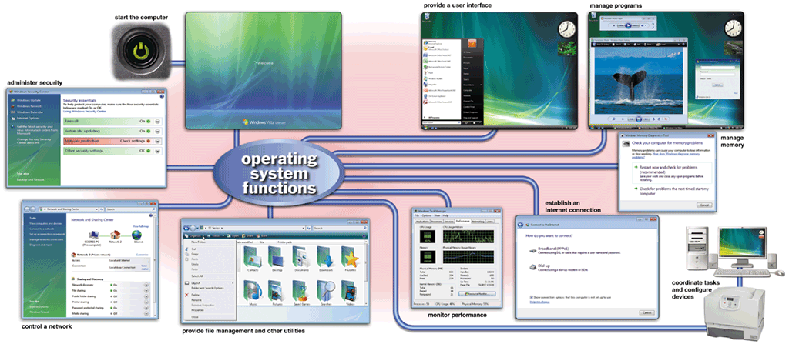
Operating Systems
What are the functions of an operating system?
p. 250 - 251 Fig. 7-1
Next

Slide 5
Operating Systems
What is a cross-platform application?
Runs identically on multiple operating systems
Operating system that computer uses is sometimes called the platform
Application
Operating System/ Platform A
Operating System/ Platform B
Operating System/ Platform C
Operating System/ Platform D
p. 252
Next

Slide 6
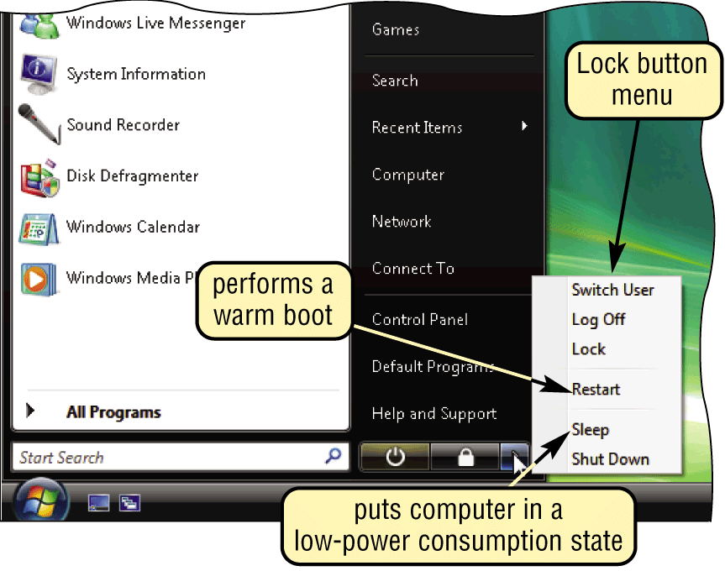
Operating System Functions
1. BOOTING.
Process of starting or restarting a computer
Cold boot Turning on computer that has been powered off
Warm boot Restarting computer that is powered on
p. 252 Fig. 7-2
Next

Slide 7
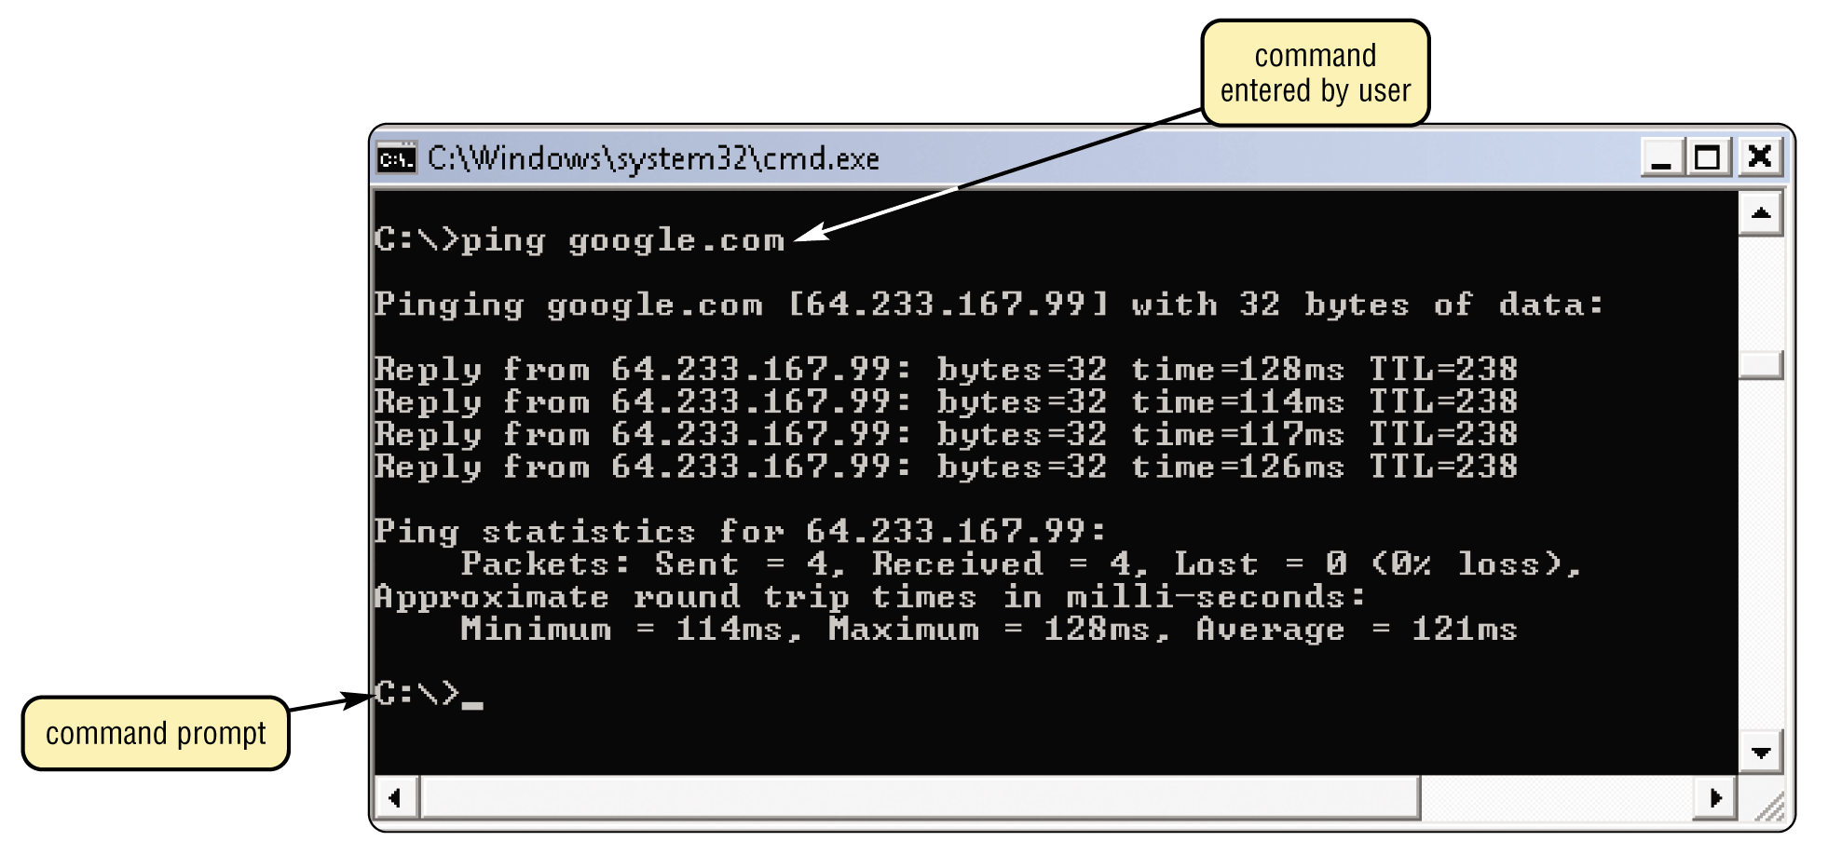
Operating System Functions…
2. PROVIDES USER INTERFACE
Interface controls how you enter data and instructions and how information displays on screen
With a command-line interface, a user types commands or presses special keys on the keyboard to enter data and instructions
p. 253 Fig. 7-3a
Next

Slide 8
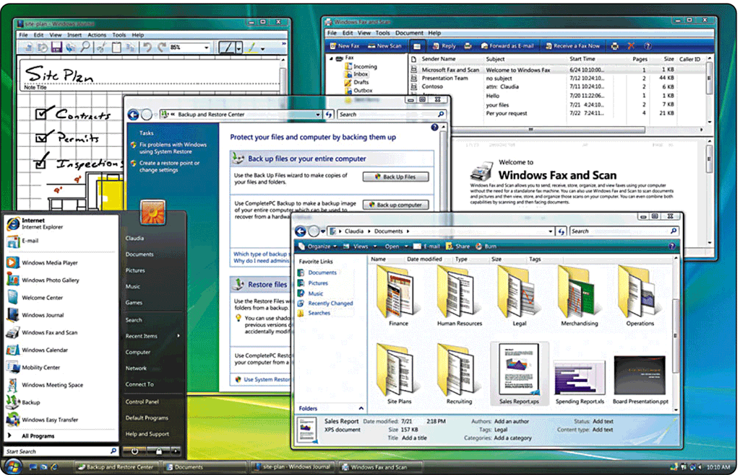
Operating System Functions…
What is a graphical user interface (GUI)?
User interacts with menus and visual images such as buttons and other graphical objects to issue commands
p. 253 Fig. 7-3b
Next

Slide 9
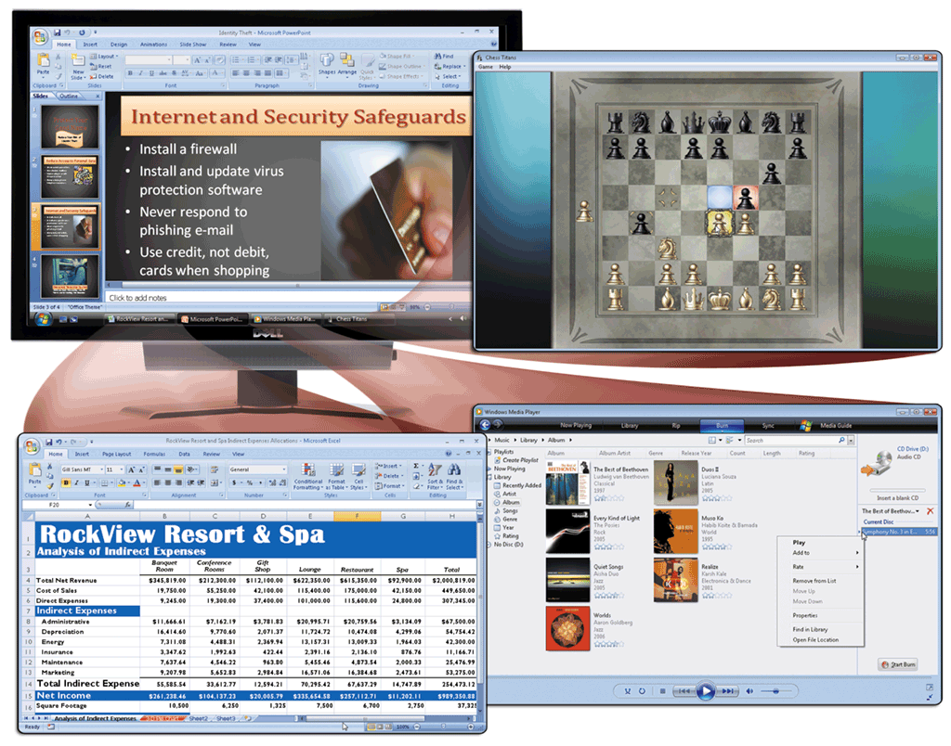
Operating System Functions
What is single user/ multitasking?
Working on two or more programs that reside in memory at same time
Foreground contains program you are using
Background contains programs that are running but are not in use
p. 253 - 254 Fig. 7-4
Next

Slide 10
Operating System Functions
What are other program management features of operating systems?
Enables two or more users to run programs simultaneously
multiprocessing
Can support two or more processors running programs at same time
multiuser
Has duplicate components such as processors, memory, and disk drives
fault-tolerant computer
Continues to operate when one of its components fails
p. 255
Next

Slide 11
Operating System Functions…
3. MANAGES MEMORY.
Optimizing use of random access memory (RAM)
With virtual memory (VM), portion of hard disk is allocated to function as RAM
p. 255
Next

Slide 12
Operating System Functions
4. MANAGES JOB SCHEDULING
How does an operating system schedule jobs?
Adjusts schedule based on job’s priority
Receiving data from input device
Sending information to output device
A job is operation the processor manages
Processing instructions
Transferring items between storage and memory
p. 255
Next

Slide 13
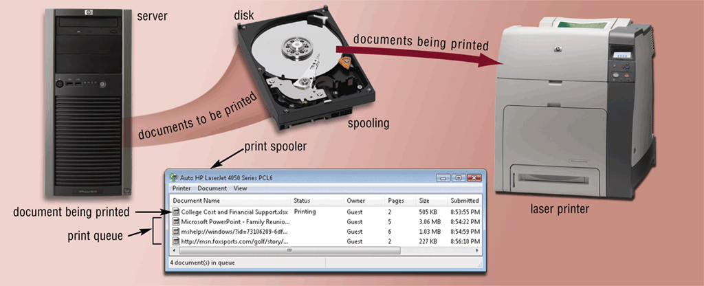
Operating System Functions
5. SPOOLING.
Sending print jobs to buffer instead of directly to printer
Print jobs line up in queue
p. 256 Fig. 7-5
Next

Slide 14
Operating System Functions…
6. MANAGES DRIVERS.
What is a driver?
Program that tells operating system how to communicate with device
With Plug and Play, operating system automatically configures new devices as you install them
Driver
Click to view Web Link, click Chapter 7, Click Web Link from left navigation,
then click Plug and Play below Chapter 7
p. 256
Next

Slide 15
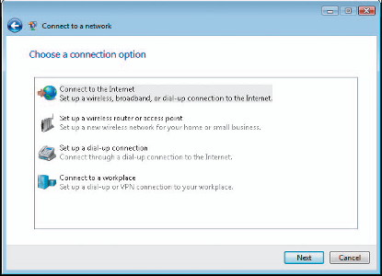
Operating System Functions
7. INTERNET CONNECTION.
How do you establish an Internet connection?
Windows Vista includes Connect to a network wizard
Guides user through setting up connection between computer and Internet
p. 256 - 257 Fig. 7-6
Next

Slide 16
Operating System Functions
8. PERFORMANCE MONITORING.
How does an operating system monitor performance?
Provides program, called performance monitor, that assesses and reports information about various computer resources and devices
p. 257
Next

Slide 17
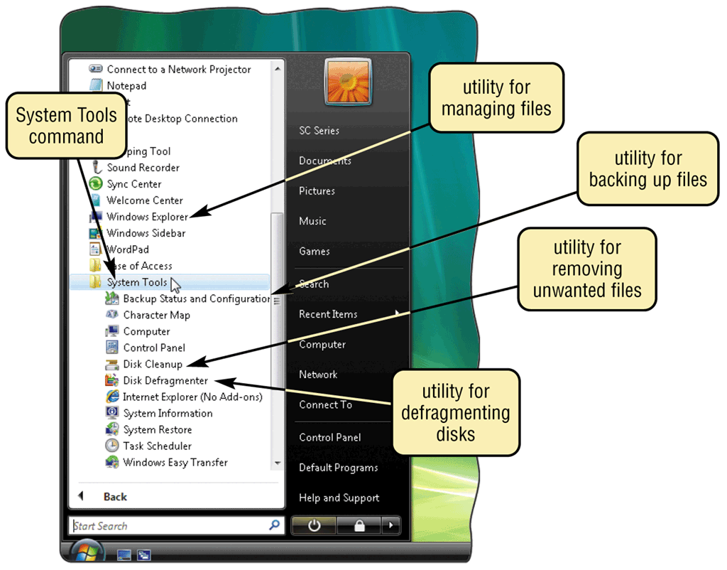
Utility Programs
What is a utility program?
System software that performs maintenance-type tasks
Also called utility
p. 259 Fig. 7-8
Next

Slide 18
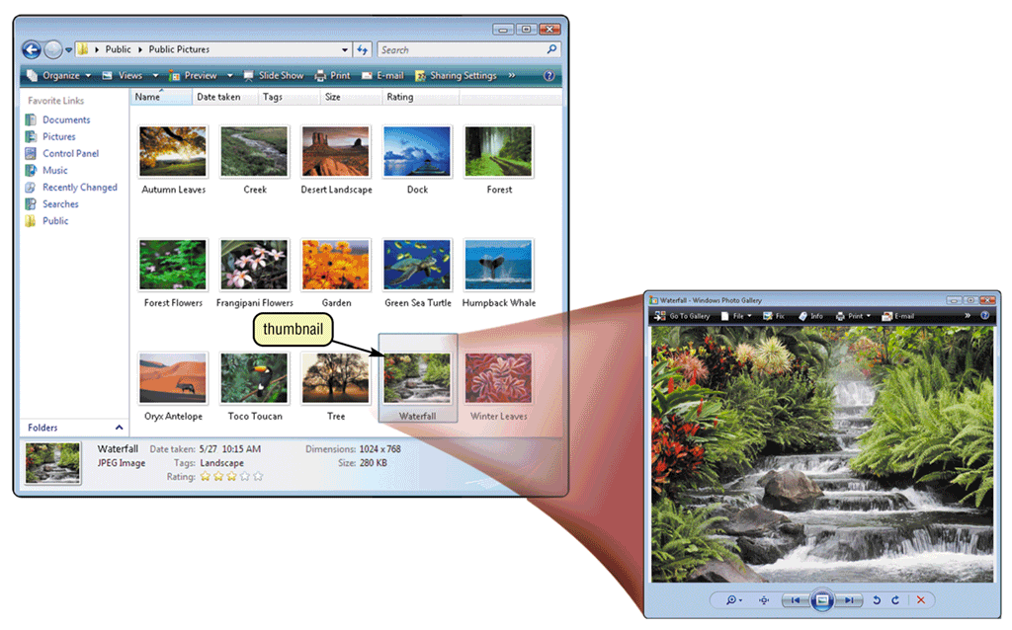
Utility Programs…
1. File manager?
Performs functions such as formatting, copying, renaming, deleting, and moving files
Search utility attempts to locate files on your computer
Image viewer displays contents of graphics file when you double click on it
p. 259 Figs. 7-9–7-10
Next

Slide 19
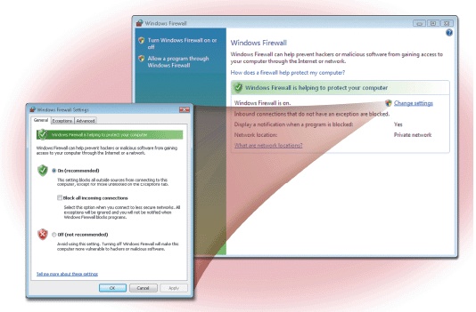
Utility Programs…
2. Firewall
Detects and protects a personal computer from unauthorized intrusions
Windows Vista automatically enables the built-in personal firewall upon installation
Click to view Web Link, click Chapter 7, Click Web Link from left navigation,
then click Personal Firewalls below Chapter 7
p. 260 Figs. 7-11
Next

Slide 20
Utility Programs…
3. Uninstaller
Removes a program and all associated files
p. 260
Next

Slide 21
Utility Programs…
What is a disk scanner?
Searches for and removes unnecessary files
Windows Vista includes a disk scanner utility called Disk Cleanup
p. 260
Next

Slide 22
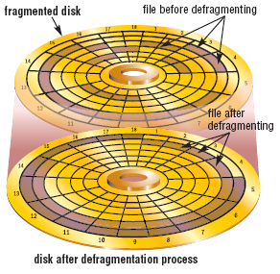
Utility Programs…
What is a disk defragmenter?
Reorganizes files and unused space on hard disk so programs run faster
p. 261 Fig. 7-12
Next

Slide 23
Utility Programs…
What is a diagnostic utility?
Compiles technical information about hardware and certain system software
Prepares report outlining problems
What is a backup utility?
Copies selected files or entire hard disk onto another storage medium
Most compress files during backup to require less storage space
A restore program reverses the backup process and returns backed up files to their original form
p. 261
Next

Slide 24
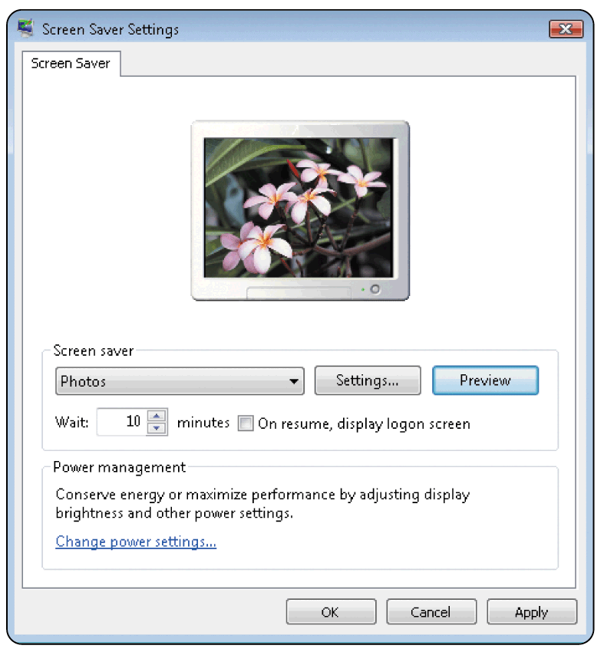
Utility Programs…
What is a screen saver?
Causes monitor’s screen to display moving image or blank screen if there is no activity for a specified time
To secure computer, user configures screen saver to require password to deactivate
Click to view Web Link, click Chapter 7, Click Web Link from left navigation,
then click Screen Savers below Chapter 7
p. 261 Fig. 7-13
Next

Slide 25
Types of Operating Systems
What are three categories of operating systems?
Embedded
Network
Stand-alone
p. 262
Next

Slide 26
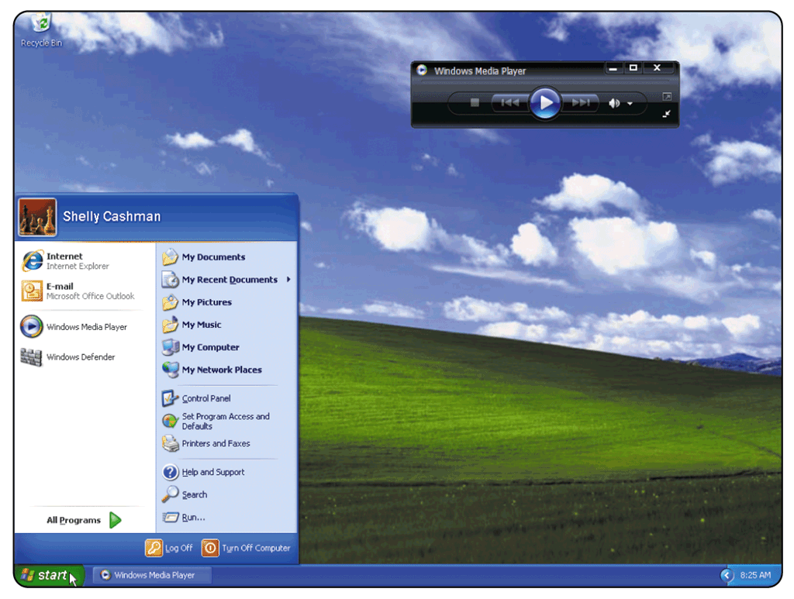
Stand-Alone Operating Systems
What is Windows XP?
Fast, reliable Windows operating system
Available in five editions: Home Edition, Professional Edition, Tablet PC Edition, Media Center Edition, and Professional 64-bit Edition
p. 262 - 263 Fig. 7-15
Next

Slide 27
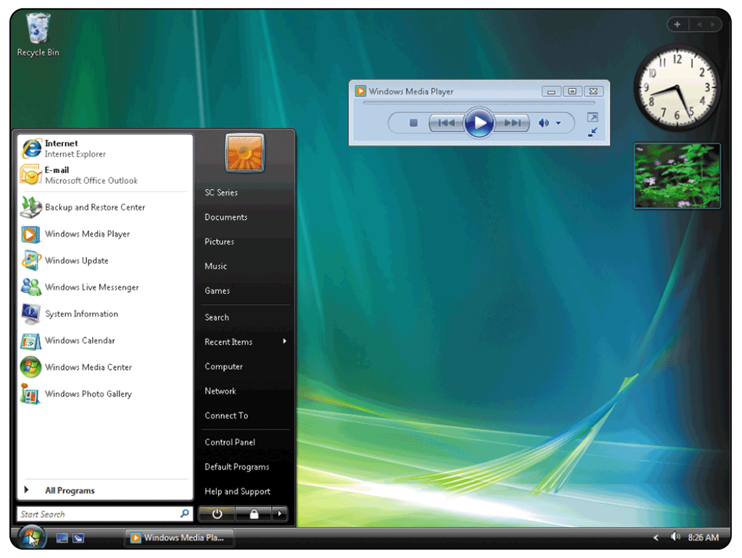
Stand-Alone Operating Systems
What is Windows Vista?
Successor to Windows XP, containing a new interface and new / enhanced features
Available in several editions, grouped into Home and Business categories
Click to view Web Link, click Chapter 7, Click Web Link from left navigation,
then click Windows Vista below Chapter 7
p. 263 Fig. 7-16
Next

Slide 28
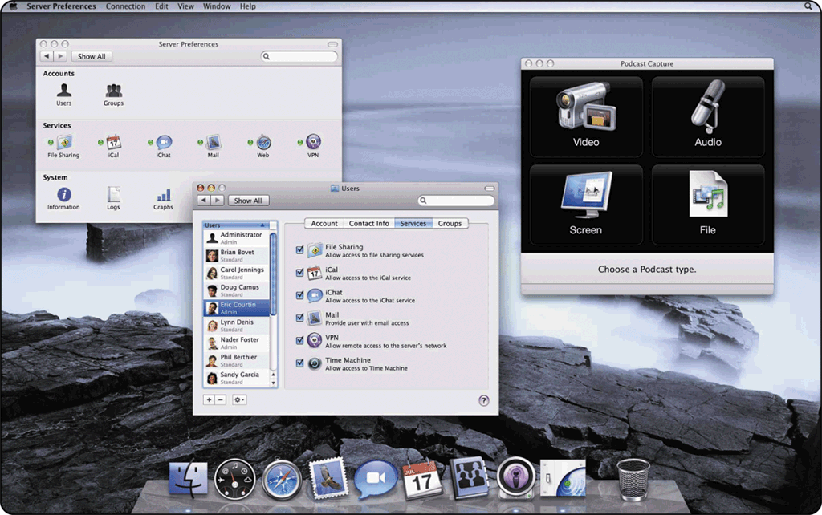
Stand-Alone Operating Systems
What is Mac OS X?
Available only for computers manufactured by Apple
Macintosh operating system has been model for most GUIs
Click to view Web Link, click Chapter 7, Click Web Link from left navigation,
then click Mac OS X below Chapter 7
p. 264 Fig. 7-17
Next

Slide 29
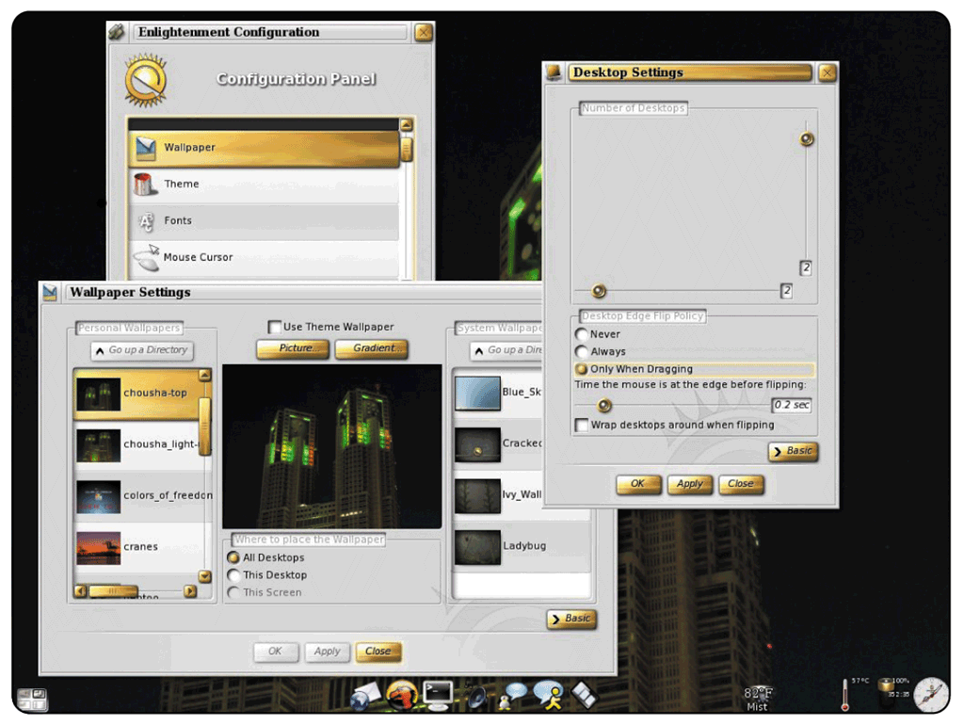
Stand-Alone Operating Systems
What is UNIX?
Used by power users because of its flexibility and power
Most versions offer GUI
Available for computers of all sizes
p. 264 Fig. 7-18
Next

Slide 30
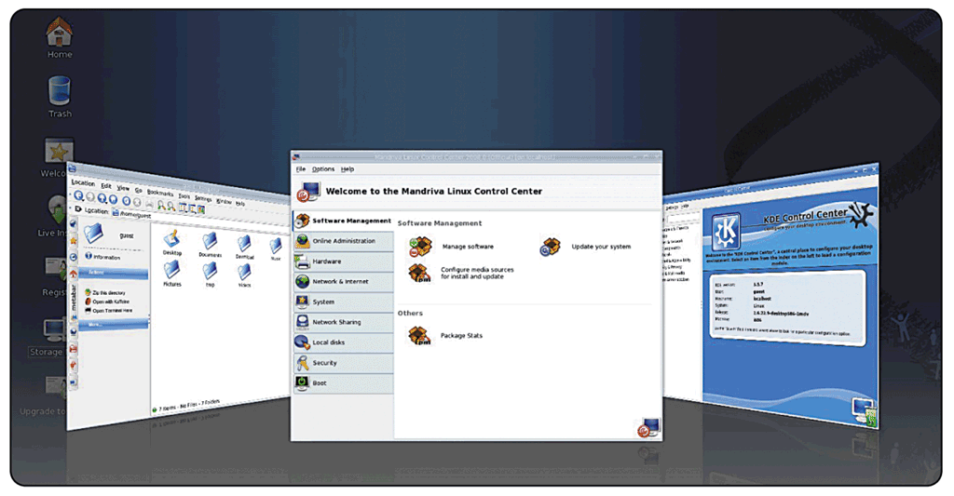
Stand-Alone Operating Systems
What is Linux?
Popular, free, multitasking UNIX-type operating system
Open-source softwaree— code is available to public
Both a stand-alone and a network operating system
Next

Slide 31
Network Operating Systems
What are examples of network operating systems?
NetWare
Designed for client/server networks
Unix and Linux
Multi-purpose operating system
Windows Server 2008
Upgrade to Windows 2003 Server
Solaris
Version of UNIX developed by Sun Microsystems
Specifically for e-commerce applications
p. 266
Next

Slide 32
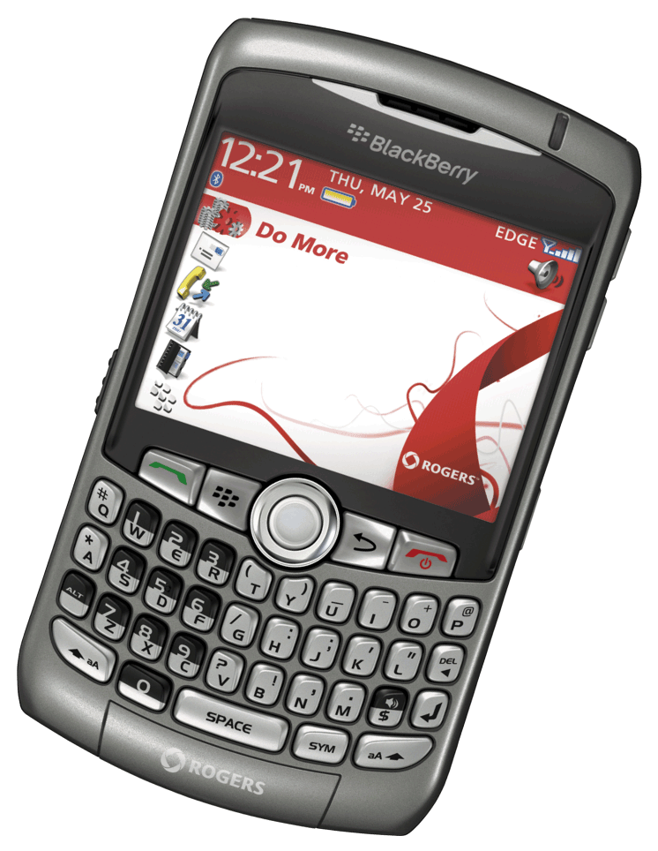
Embedded Operating Systems
What is an embedded operating system?
Found on most mobile computers, PDAs, and other small devices
Windows Embedded CE is scaled-down version of Windows
Windows Mobile for Pocket PC
Palm OS for Palm
BlackBerry OS
Embedded Linux
Symbian OS
Click to view Web Link, click Chapter 7, Click Web Link from left navigation,
then click BlackBerry below Chapter 7
p. 266 - 267 Fig. 7-20
Next

Slide 33
Stand-Alone Utility Programs
What is a virus?
Potentially damaging computer program
Affects computer without user’s knowledge
An unusual message or image is displayed on the computer screen
An unusual sound or music plays randomly
The available memory is less than what should be available
A program or file suddenly is missing
An unknown program or file mysteriously appears
The size of a file changes without explanation
A file becomes corrupted
A program or file does not work properly
System properties change
The operating system runs much slower than usual
SIGNS OF VIRUS INFECTION
p. 267 Fig. 7-21
Next

Slide 34
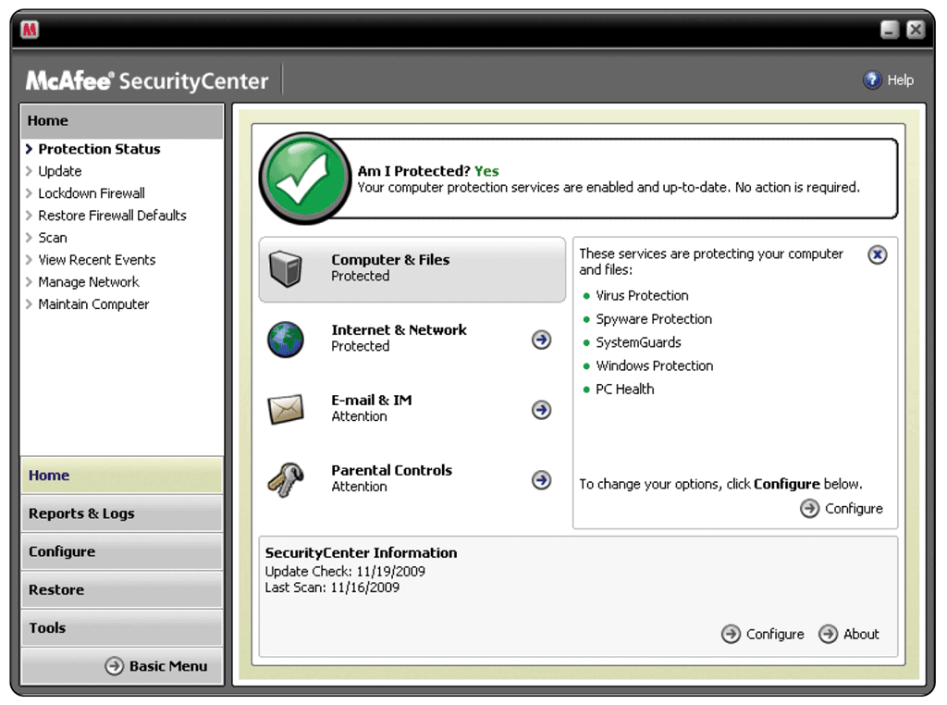
Stand-Alone Utility Programs
What is an antivirus program?
Identifies and removes viruses in memory, storage media, and incoming files
Must be updated frequently
p. 268 Fig. 7-22
Next

Slide 35
Stand-Alone Utility Programs
What is spyware?
Program placed on a computer without the user’s knowledge that secretly collects information about the user
Often enters a computer as a result of a user installing a new program
A spyware remover is a program that detects and deletes spyware, adware, and similar programs
p. 268
Next

Slide 36
Stand-Alone Utility Programs
What are internet filters?
Programs that remove or block certain items from being displayed
Anti-Spam
Programs
Web Filters
Phishing Filters
Pop-up Blockers
Click to view Web Link, click Chapter 7, Click Web Link from left navigation, then click Phishing Filters below Chapter 7
p. 268 - 269
Next

Slide 37
Stand-Alone Utility Programs
What is a file compression utility?
Shrinks size of files to free up room and improve performance
Compressed files are sometimes called zipped files
p. 269
Next

Slide 38
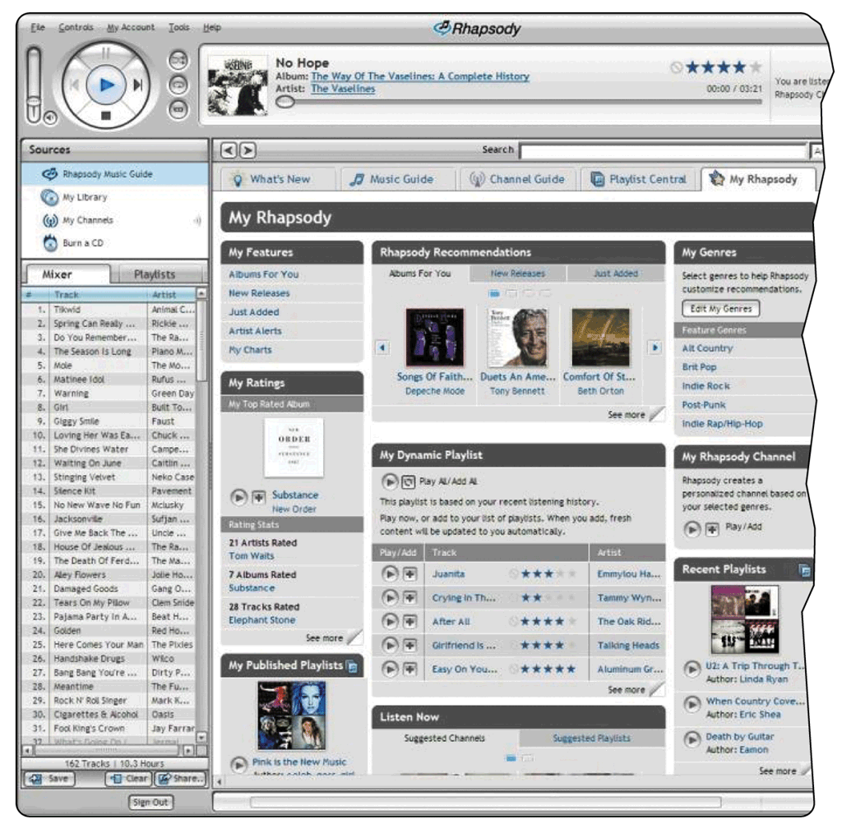
Stand-Alone Utility Programs
What is a media player?
Allows you to view images and animation, listen to audio, and watch video files on your computer
p. 269 Fig. 7-23
Next

Slide 39
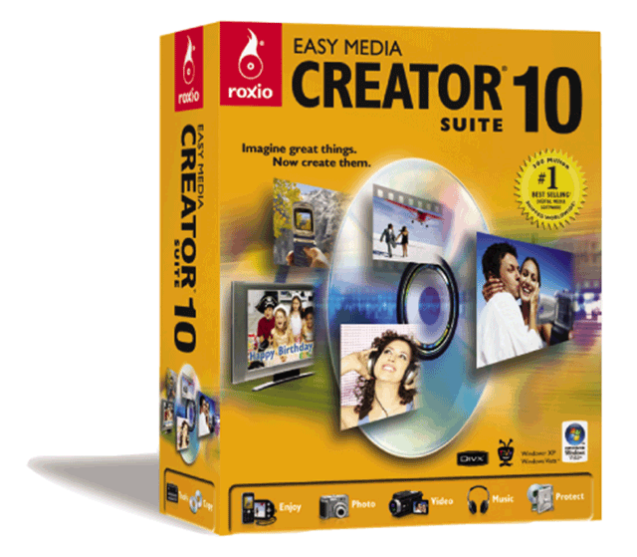
Stand-Alone Utility Programs
What is CD/DVD burning software?
Writes text, graphics, audio, and video files to a recordable or rewriteable CD or DVD
p. 269 Fig. 7-24
Next

Slide 40
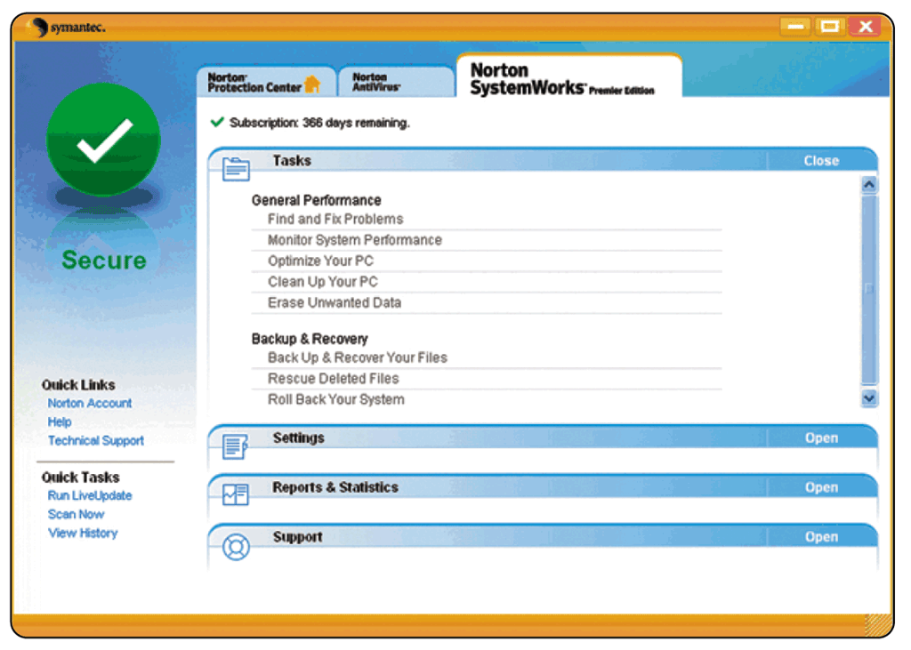
Stand-Alone Utility Programs
What is a personal computer maintenance utility?
Identifies and fixes operating system problems and disk problems
Some continuously monitor computer to identify problems before they occur
p. 270 Fig. 7-25
Next

Slide 41
Summary of Operating Systems and Utility Programs
Define an operating system
Discuss a variety of stand-alone operating systems, network operating systems, and embedded operating systems
Discuss the functions common to most operating systems
Describe several stand-alone utility programs
Introduce several utility programs commonly found in operating systems

